Slide 1
Data quality & VGI
Ordnance Survey GB
Jeremy Morley
Jenny Harding & Claire Pook
April 2017
COST Action TD1202 Final Meeting, RGS, London, 13/10/16

Slide 2
Outline
Context - Data quality and Ordnance Survey workflow
VGI and quality in current products and applications
Research – applying VGI approaches

Slide 3
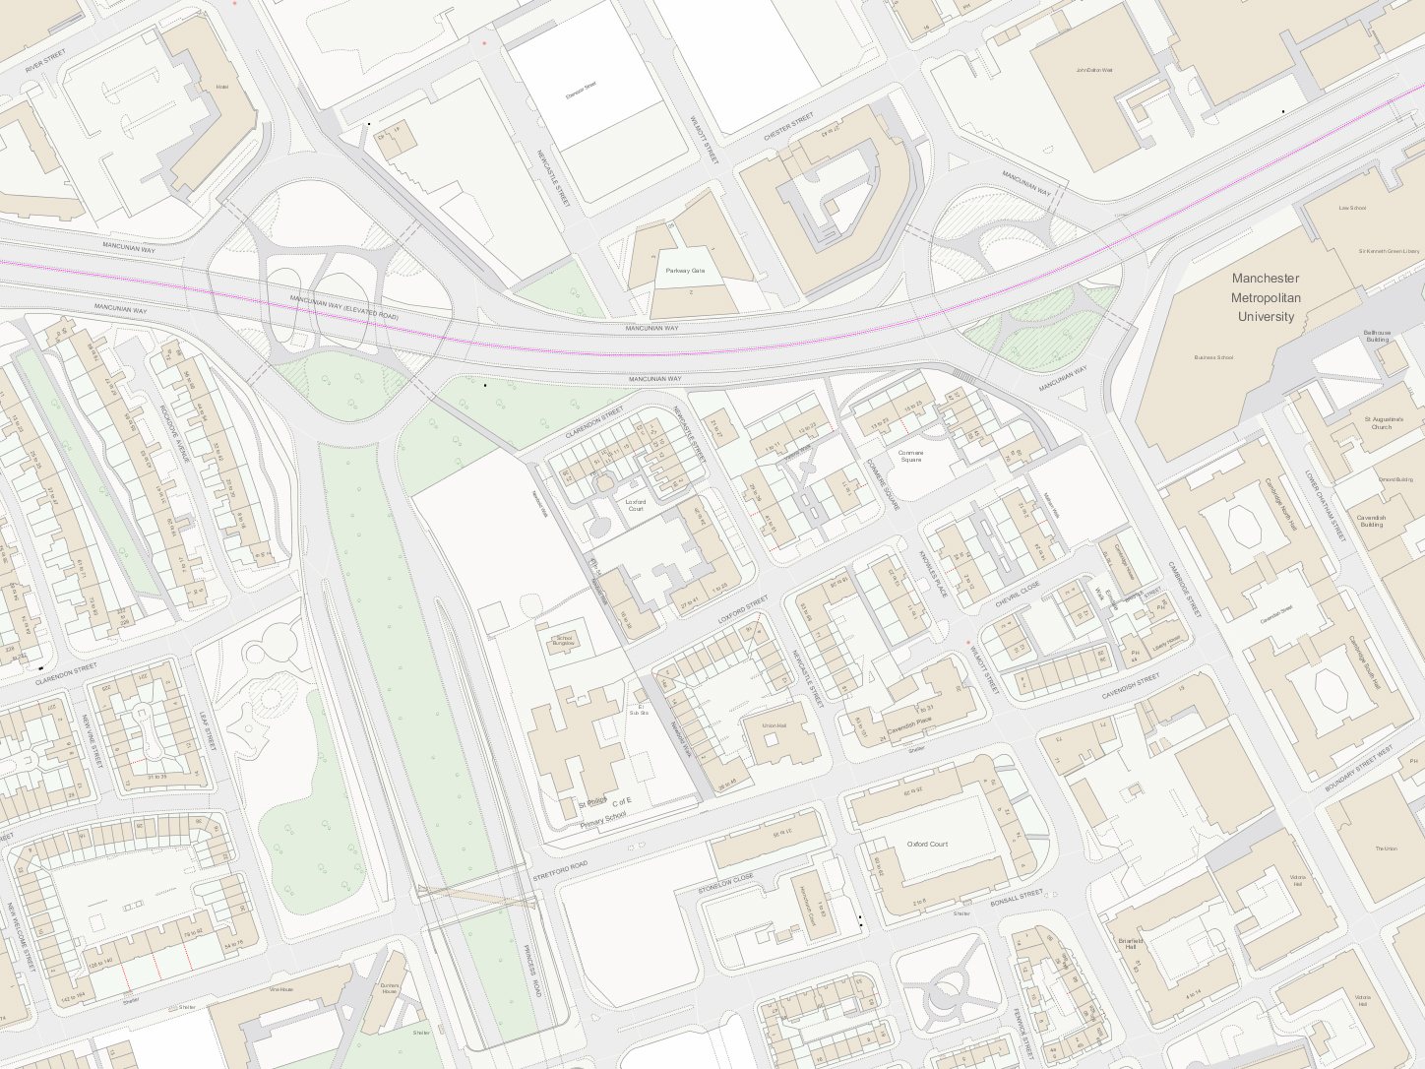
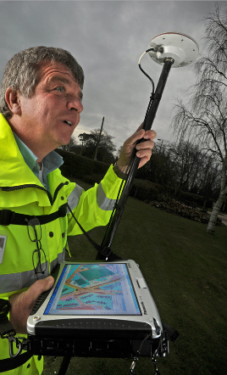
Data Quality management aims
Consistent and sustainable quality
Customer requirement
Risk management
ISO 19158 Geographic Information:
Quality Assurance for data supply

Slide 4






traditional data set-ups are being challenged
Data collection and
Source Systems
Mapping and ETL
Data warehouse
Spatial Database
BI & analytics
Staging
Dashboards
Reporting
Data Access/Services
OLTP
ERP
CRM
LOB
POI
Map
Image
Navigation

Slide 5
Digitisation produces data volume and silos
50x Data growth 2010-2020
1Trillion Web pages
40ZB Digital Universe 2020
1
Increasing data volumes
Data collection and
Source Systems
Mapping and ETL
Data warehouse
Spatial Database
BI & analytics
Staging
Dashboards
Reporting
Data Access/Services
OLTP
ERP
CRM
LOB
POI
Map
Image
Navigation

Slide 6
real time response and action is required
1
2
Increasing data volumes
Real-Time Data/Response
Data collection and
Source Systems
Mapping and ETL
Data warehouse
Spatial Database
BI & analytics
Staging
Dashboards
Reporting
Data Access/Services
OLTP
ERP
CRM
LOB
Dashboards
Reporting
POI
Map
Image
Navigation

Slide 7
Less than 20% of iot data is structured
1
2
Increasing data volumes
Real-Time
Data collection and
Source Systems
Mapping and ETL
Data warehouse
Spatial Database
BI & analytics
Staging
Dashboards
Reporting
Data Access
OLTP
ERP
CRM
LOB
Dashboards
Reporting
New data
POI
Map
Image
Navigation
3
15x
Machine generated data 2020
2.4M
Facebook content per minute
1.3M Hours on Skype per hour
New data types
Devices
Web
Sensors
Social

Slide 8
Data lives and breathes in the cloud
1
2
Increasing data volumes
Real-Time
Data collection and
Source Systems
Mapping and ETL
Data warehouse
Spatial Database
BI & analytics
Staging
Dashboards
Reporting
Data Access
OLTP
ERP
CRM
LOB
Dashboards
Reporting
New data
3
4
$100B spend on cloud
40% CRM sold
are SaaS
50% large orgs have hybrid by 2017
New data types
Cloud-born data
Devices
Web
Sensors
Social

Slide 9
where in the workflow DOES VGI FIT?
Specification of data & accreditation of suppliers
Quality Assurance – analysis & investigation
Quality management information
Change detection
Production area
Database
Products & services
customers
Products & services
Products & services
Production area
QC
Products & services
Production area
VGI (?)
VGI
Notes:
Supplier accreditation to ISO 19158 standard

Slide 10
VGI CONTINUUM
Passive data mining
Crowd uploaders
Crowd sensors
Crowd contributors
Crowd visual processors
Crowd scientists / analysts / engineers
Crowd defines and owns the problem

Slide 11
VGI – ELEMENTS of SUCCESS
ADVERTISING
Do people hear about the project?
MOTIVATION
Are they interested in the proposition?
HUMAN FACTORS
Is the system usable, maybe even fun?
Notes:
Motivation – singular proposition (tell us vernacular geography names by postcode) vs multi-purpose (OSM – many reasons to engage)
System - may be considering HCI of a web interface; but the system in OSM is much broader

Slide 12
COVERAGE OF Our Current PhDs
Analytics
Enriching 3D Building Models
Cardiff
3D
Natural Language - spatial location descriptions
Massey (NZ)
Design for
human use
Realtime Urban Data Spaces
UCL CASA
3D data requirements & quality
UCL
Automated map content selection for multi-modal travel
Edinburgh
Exploiting multiray photogram. for urban 3D
Newcastle
Temporal activity modelling of cartographic objects
Southampton
GeoBIM
Newcastle
Detecting Transient Geographies
Southampton
Web Sciences
Situational Relevance of Mobile Maps and Media
Nottingham
Geography of events from social media
Swansea + SME (Blurrt)
Geo-spatial Technology and Sensory Geographies
Royal Holloway
Places & spaces
Deep Learning
Lancaster
Negotiating Environments - tracking environmental and mediated information use
Swansea
Crowd-sourcing & land rights in crofting communities
Edinburgh
Role & uses of location & vernacular geography within identities of people and communities
Nottingham
Machine learning to derive vernacular geography from social media
RHUL
Human-Machine Interfaces for navigation of autonomous vehicles
Nottingham
Vernacular geography & personal data
Nottingham
Horizon CDT
Mapping Vernacular Geographies in Places of Super-Diversity
Royal Holloway
Notes:
Further details of running PhD projects can be provided as slide decks or posters from our February research days

Slide 13
COVERAGE OF Our Current PhDs
Enriching 3D Building Models
Cardiff
3D
Analytics
Detecting Transient Geographies
Southampton
Web Sciences
Geography of events from social media
Swansea + SME (Blurrt)
Places & spaces
Crowd-sourcing & land rights in crofting communities
Edinburgh
Role & uses of location & vernacular geography within identities of people and communities
Nottingham
Machine learning to derive vernacular geography from social media
RHUL
Vernacular geography & personal data
Nottingham
Horizon CDT
Notes:
Further details of running PhD projects can be provided as slide decks or posters from our February research days

Slide 14
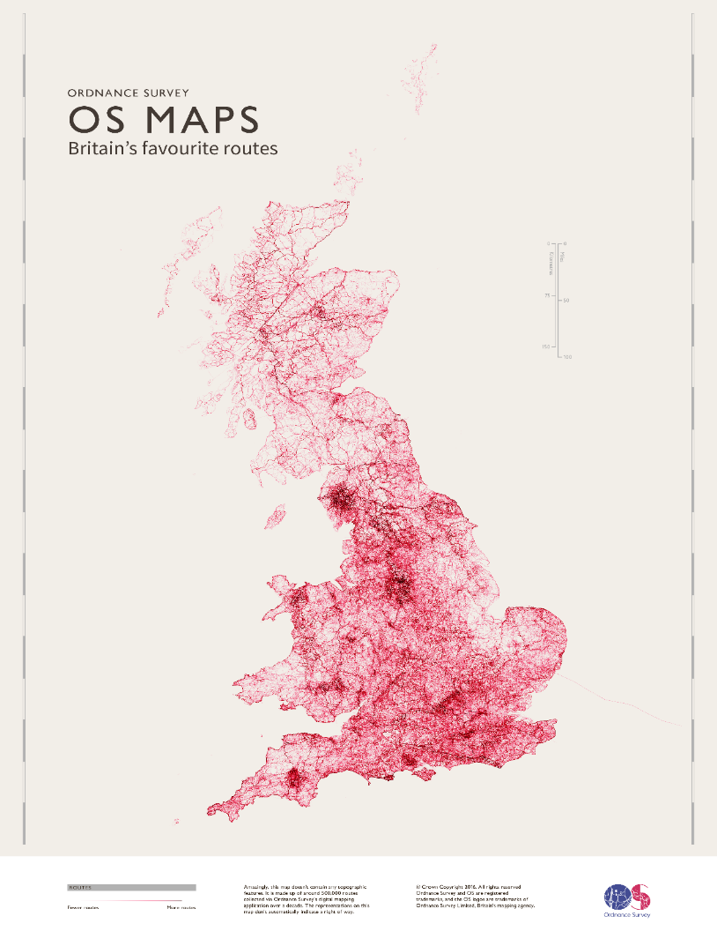
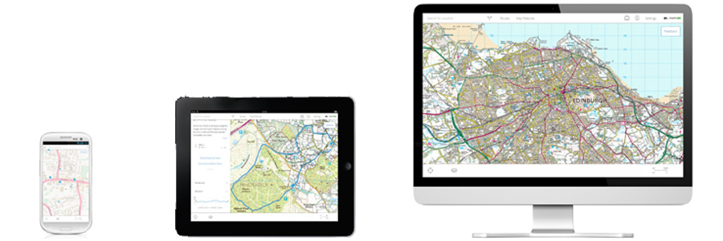
OS Maps – contributed routes
Routes shared in OS Maps app
500 000⁺ routes submitted
for shared use
Mix of traced routes and
uploaded GPS tracks
Notes:
Data content not used by os – is for users to share
But if were to…
Quality:
Posiitonal:
Digitsed can have few points, long straight sections between them eg sometimes cutting through buildings
Uploaded gps tracks can have odd spikes – possibly where GPS signal lost
Coverage: some areas low density – why? Even when there are public footpaths present
Uses??

Slide 15
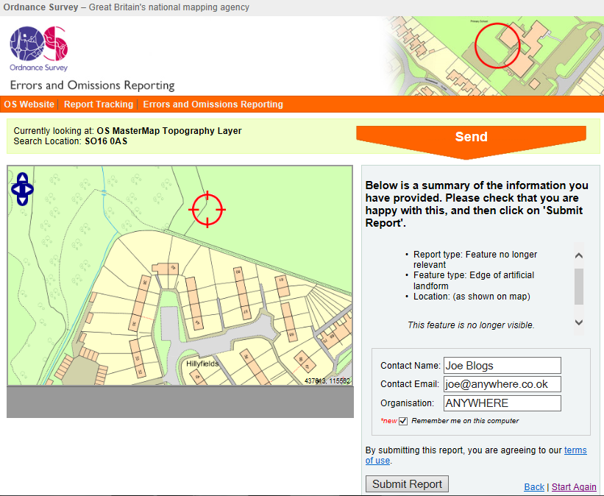
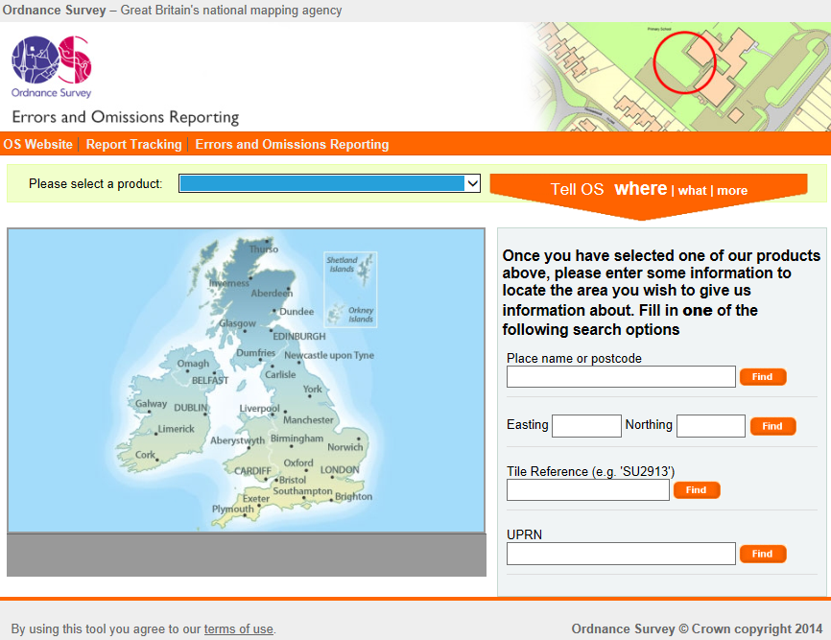
Tell OS – reporting of errors/omissions
Tool: A web map interface to enable reporting of errors/omissions
Open to public sector users
Good use levels –
c200 reports/month
Process:
Select product
Find location
Submit data……
Notes:
Can also report to CSC via email

Slide 16
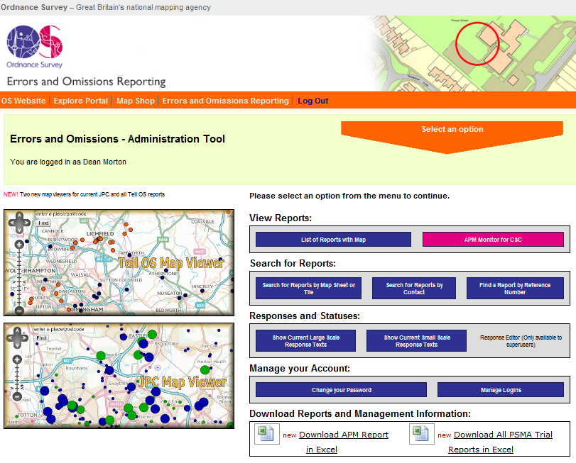
TELL OS
Contribution acknowledged +action taken
Data stored and feeds into job
operations planning
Reported points viewable
by users
Notes:
Drop down list of response types
Trusted users – spelling changes accepted – edit made by OS QA there and then
New building – QA check against imagery – create job for field or photogrammetric capture

Slide 17
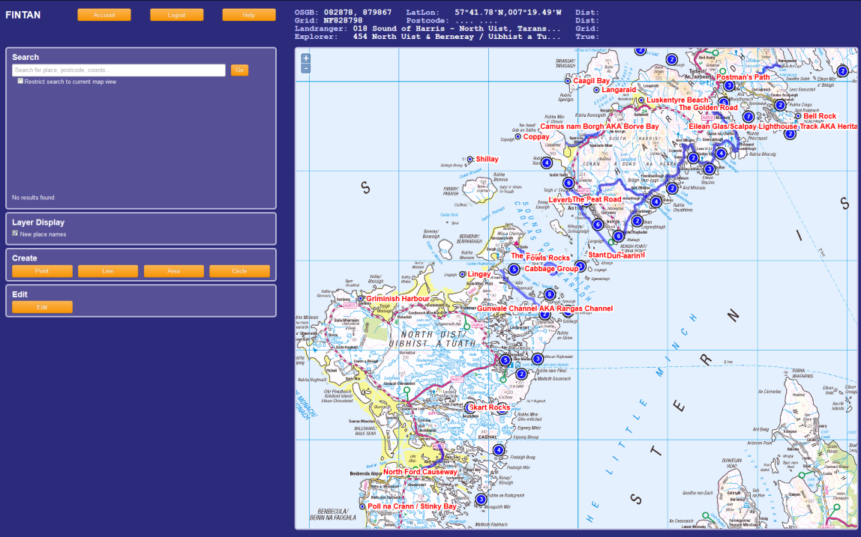
MCA ‘Fintan’ – expert VGI on local names
Web map service application for coastguard knowledge of local names
Users: operators in centralised control room for search and rescue services
Also includes names contributed by volunteer Coastguard Officers
Database contains around 6100 names with point, line or polygon location geometry
Notes:
In Irish mythology – the Salmon of Knowledge
Maps – can zoom to OSMM. Contains os gazetteer data
Quality: VG so enables capture of alternative spellings
Positional? Completeness? - any info better than none?
Attributes consistency– use of codes eg for buoys, stretches of rivers – but free text (?)

Slide 18
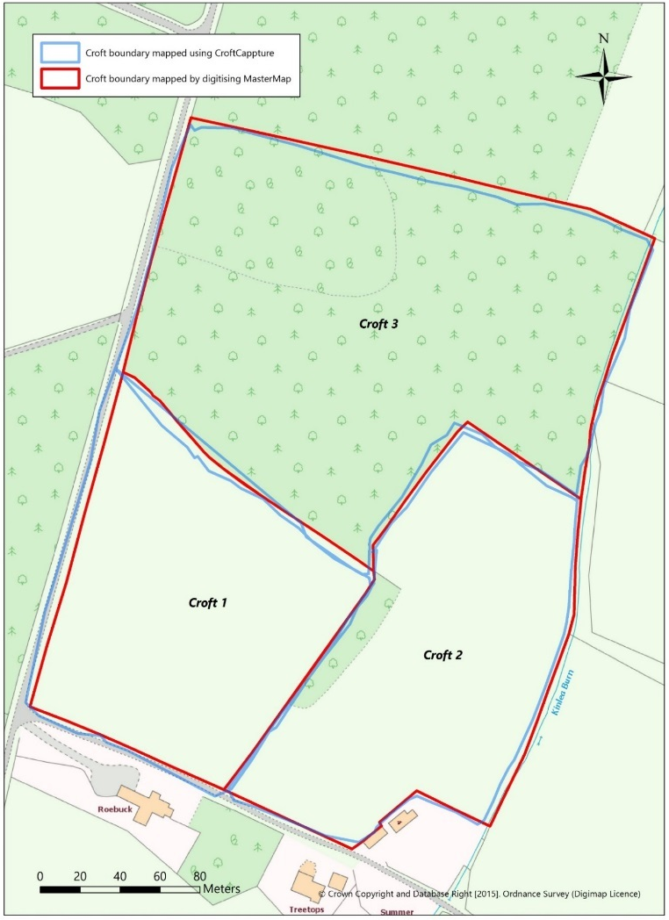
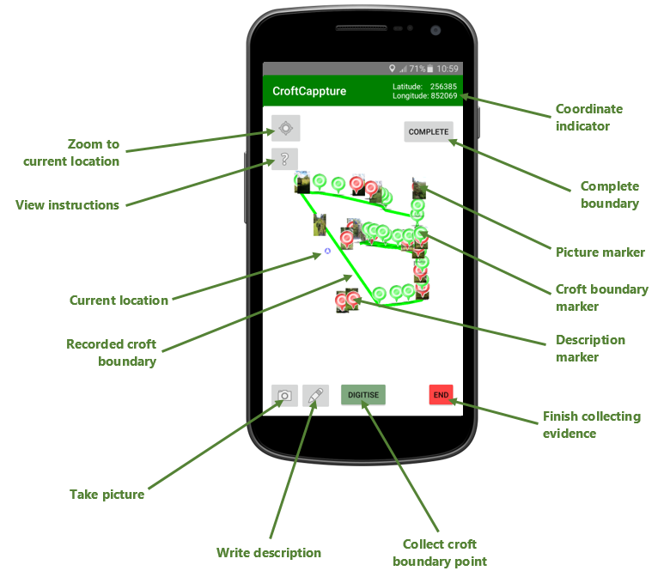
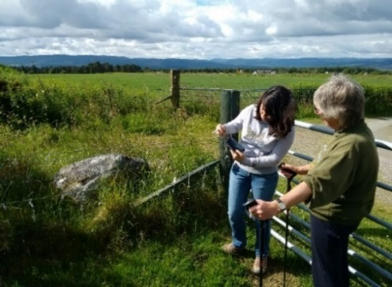
Crowd-sourcing & land rights in crofting communities
Edinburgh
Courtesy of
Rica DUCHATEAU
William MACKANESS
Edinburgh Uni
Notes:
PhD Exploring efficacy of crowd sourcing for recording boundary and land rights information
Focused on Scotland (Highlands and Islands) crofting community – form of land tenure and small scale food production (less than 50ha)
Current Registers of Scotland Crofting Register relies of crowdsourcing through hand drawn maps- RoS then digitise on OSMM.
In 2012 , still c 15000 not yet digitally spatially referenced.
(Used for croft registration applications and resolving boundary disputes)
Croftcapture app for smartphone use in field, based on OS OpenSpace SDK – software development kit
Blue line = boundary captured using app
Red line= boundary digitised from osmm
Potential benefit of app – submit already digitised using OS Open data
Crofters in sample area invited to participate
Positional accuracy errors of up to 7m in small sample – too much for land administration uses?
App developed in MSc.
PhD Focused on socio-technical issues of:
Community capacity to record and validate such info
Delineation of boundaries without physical features
Robustness of data to legal scrutiny

Slide 19
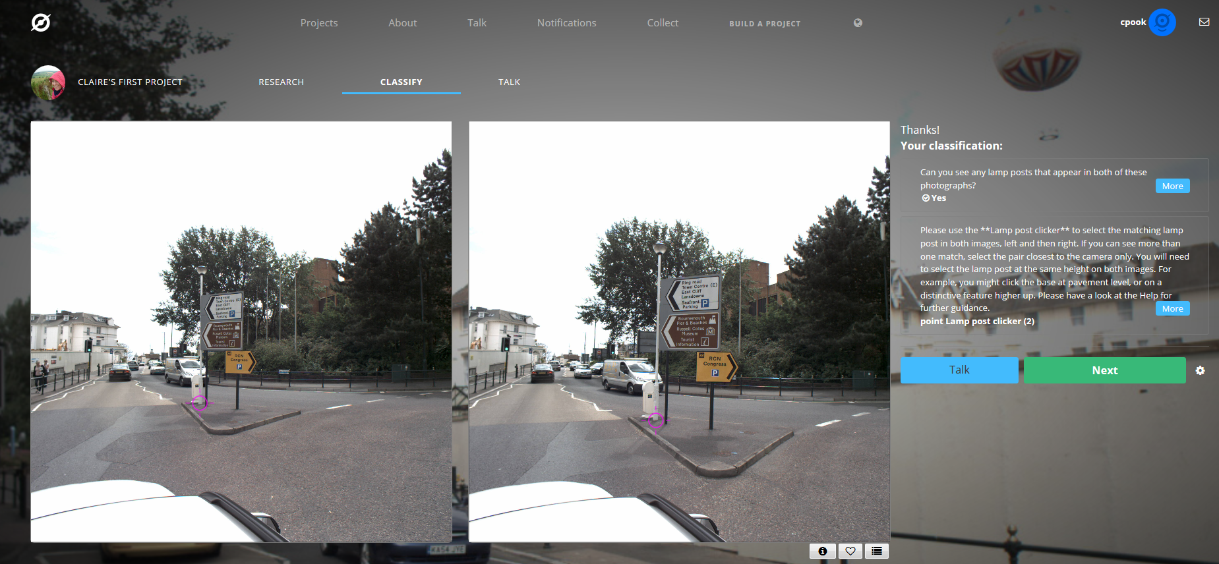
Zooniverse project

Slide 20
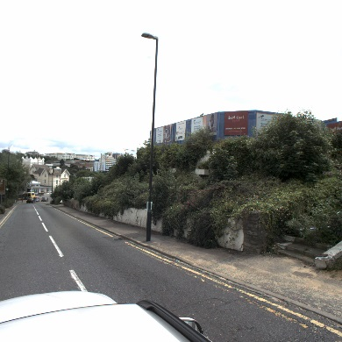
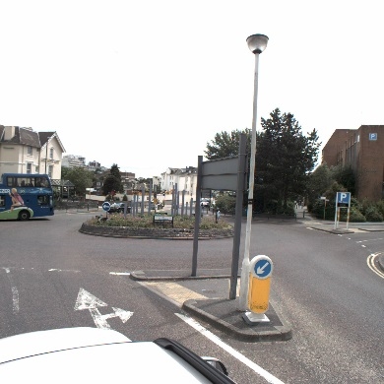
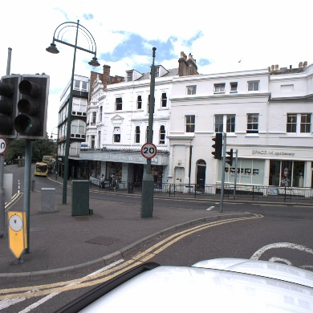

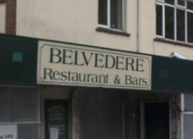
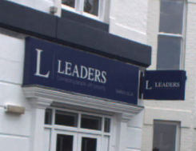
Applications chosen for trial
Street furniture
Business names
Notes:
But for now, the application that I’ve chosen to develop will allow users to tag street furniture and business names in stereo pairs of mobile mapping imagery.
Using photogrammetry software, I can then generate a 3D real world coordinate for each feature.
This could potentially feed in to a Utilities layer in our data, or contribute to the data capture required for the smart cities project.
Everybody knows what a lamp post looks like, and this application lets you go on a tour of the city where the imagery was taken.
You don’t need to have specialised point cloud software installed (it’s just a web browser), don’t need the ability to work with point clouds…

Slide 21
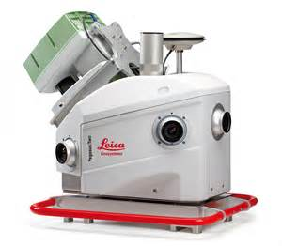
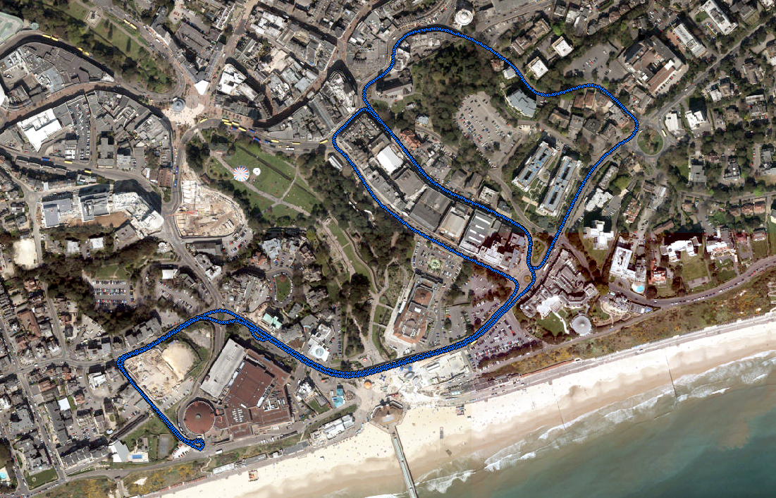
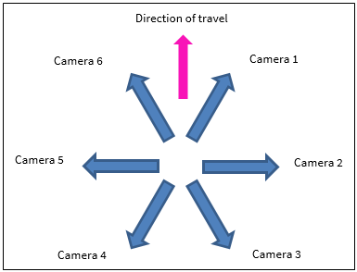
Available Ground-Based Imagery
Notes:
The mobile mapping imagery we currently have available in BC&I is of Bournemouth.
It was captured last Summer using a Leica Pegasus 2, a vehicle mounted laser scanner that also has 7 georeferenced cameras on board.
Here’s the route that was taken, and the orientation of the cameras based on the forward direction of travel.

Slide 22
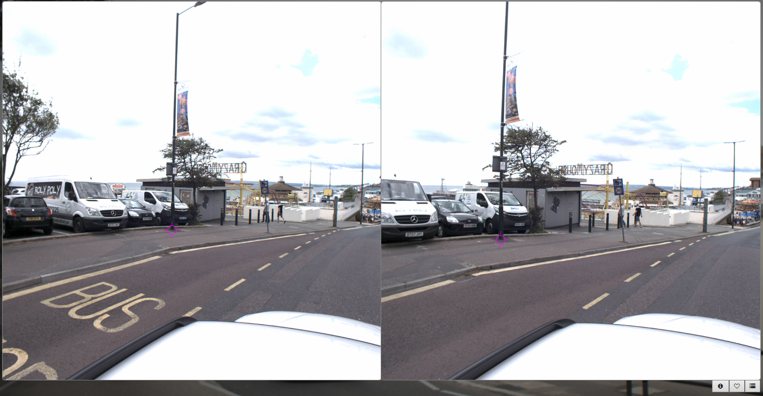
How it works
Notes:
This is a stereo pair of images, and all the user has to do is identify whether there’s a lamp post that can be clearly seen in both images, and then click at the base.
We are looking at how this will work with just one image, but at the moment you have to look for the matching feature, and identify it in both images..

Slide 23
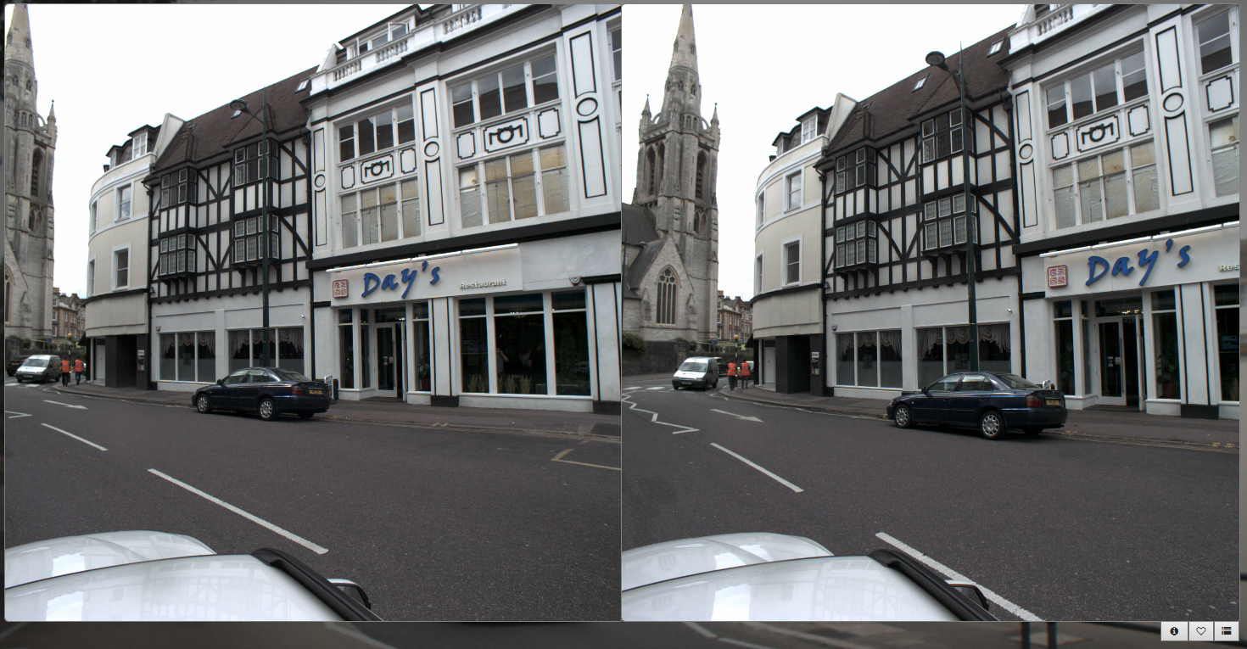
How it works

Slide 24
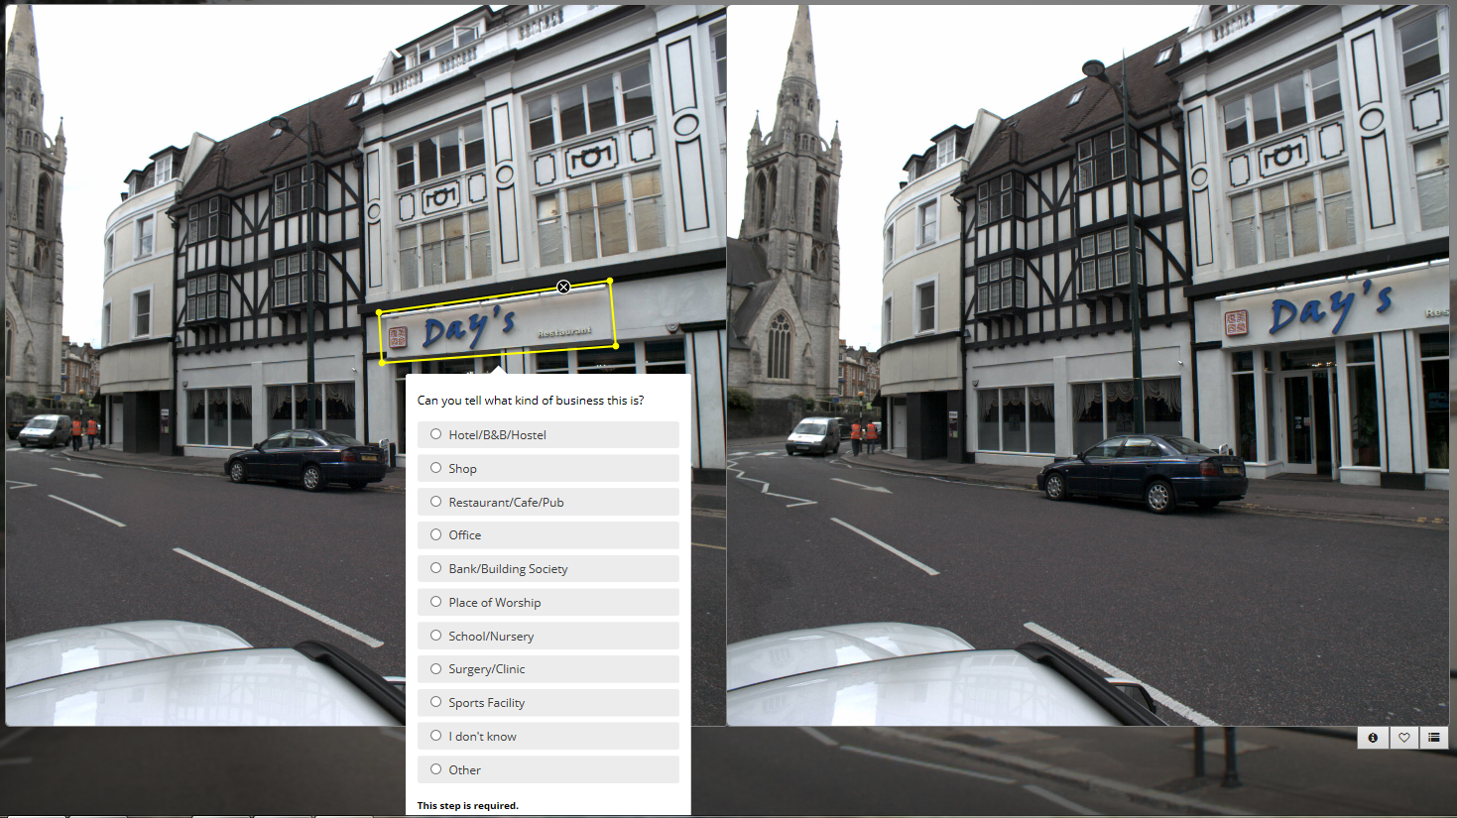
How it works
Notes:
Draw a polygon around the business name you’ve spotted, and choose the business type from a drop down list.
We don’t yet have the functionality to actually type what you see, but that’s something that will be available in the future..

Slide 25
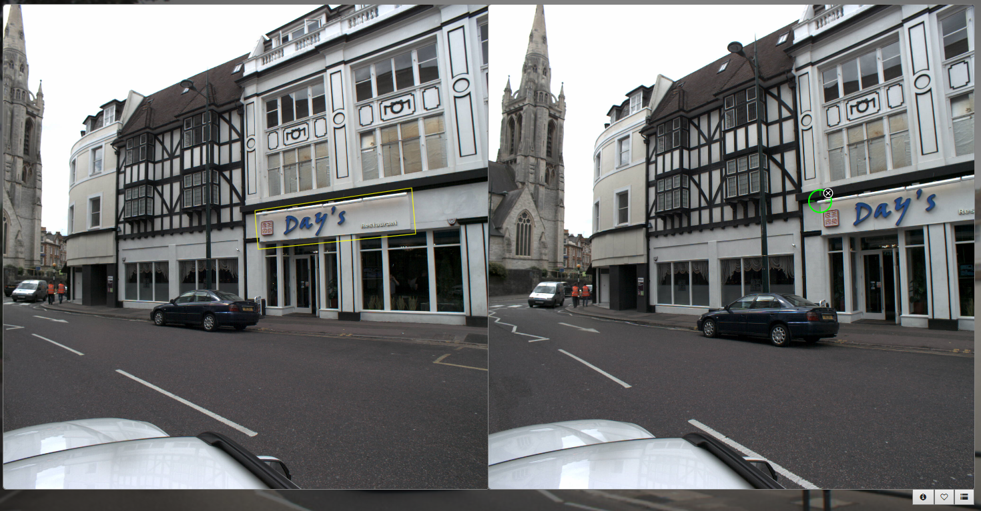
How it works

Slide 26
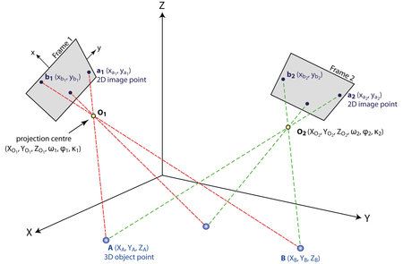

Processing the data
Left hand image coordinates (X_{local}, Y_{local})
Exterior orientation of both cameras (OSGB36 & omega, phi, kappa)
Real world coordinates of lamp post (OSGB36)
Right hand image coordinates (X_{local}, Y_{local})
Notes:
So here’s how I’ll take all the clicks and turn them into real world OSGB coordinates using the principles of aerial triangulation…

Slide 27
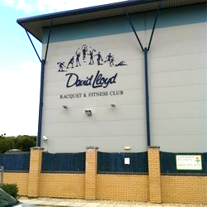
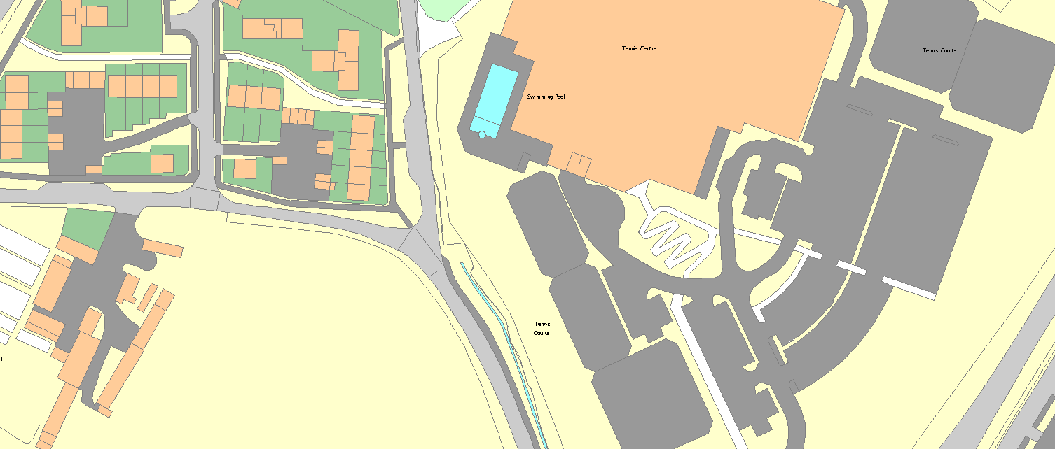

Results (IDEAL!)
Notes:
Here’s an image showing what our results might look like if we had imagery of our local area here.
There will be small clusters of coordinates all representing the same feature, so I’ll take the average of these to choose the best position. That the advantage of having numerous people view the imagery and tag the features.
Also with the business name application, I’ll be able to extract the defined polygon from the imagery, creating nice visual of what it was the user saw in the original imagery. These may also become candidates for further crowdsourced transcription tasks. Or maybe we could look at Optical Character Recognition to read what they say automatically.

Slide 28
pilot
18 volunteers asked to take part, contributing as often as they were able
Over 5000 classifications achieved in 6 weeks
Notes:
Each user had a log in, meaning I could track contributions to their owner
Instructions vs ‘having a go’
Feedback at he end of the pilot

Slide 29
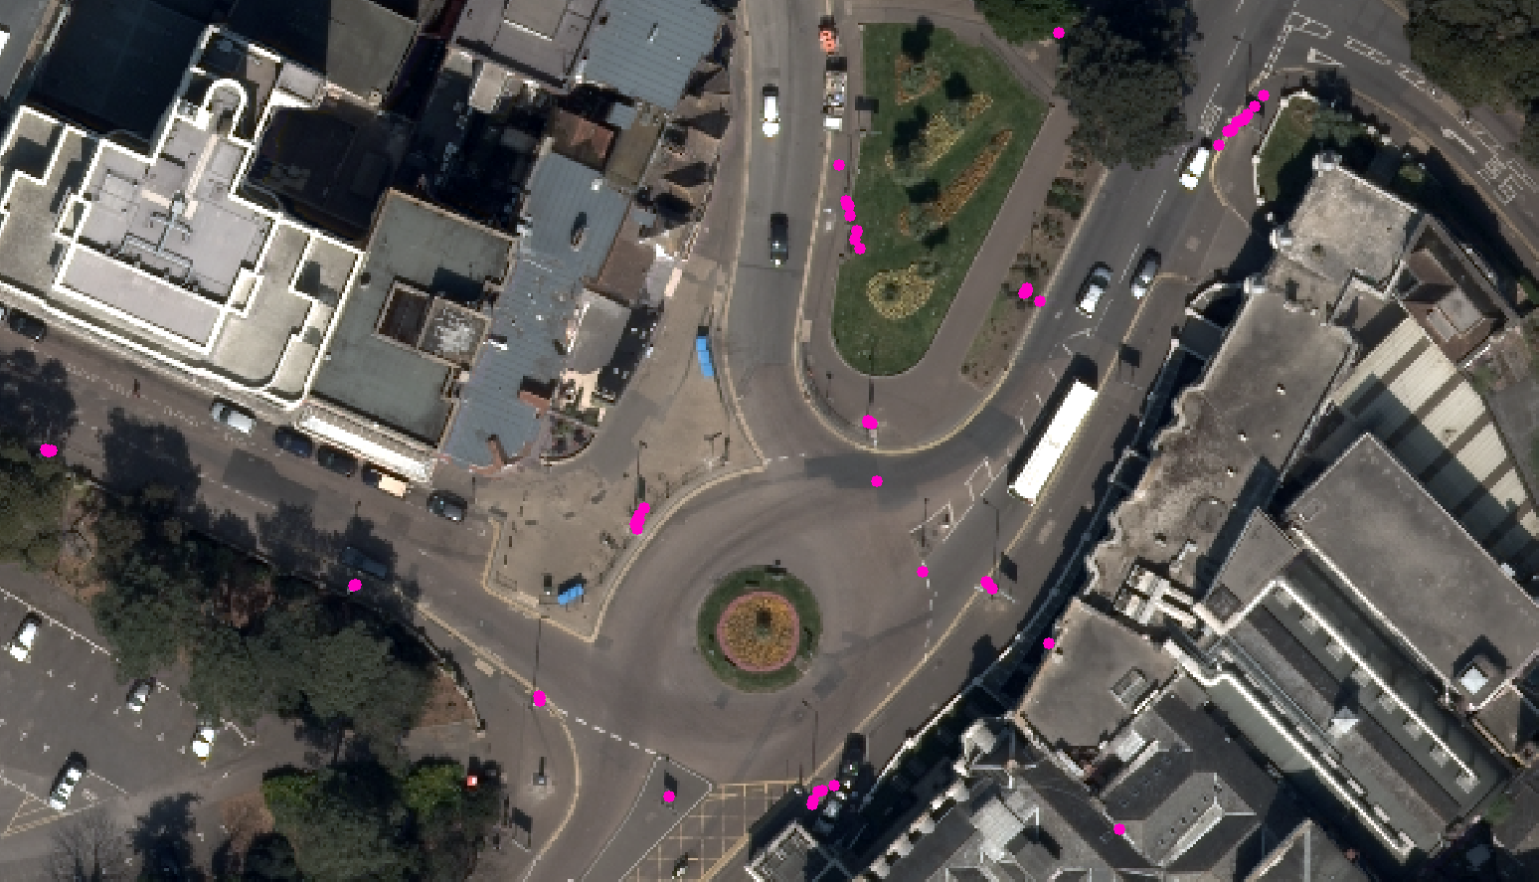
Pilot results (Lamp posts)

Slide 30












Pilot results (Business Names)

Slide 31
Zooniverse Project - Some Things to consider
We do not hold a national dataset of mobile-mapping imagery yet(!)
Information is only as current as the last time the photos were taken
Objects may be obscured by vehicles/people/trees etc
WHAT’s NEXT?
How can staff be encouraged to contribute?
Future research into crowd sourcing in a commercial environment
Notes:
We do not hold a national dataset of mobile-mapping imagery yet(!)
Information is only as current as the last time the photos were taken
Objects may be obscured by vehicles/people/trees etc
How could OS staff be encouraged to contribute in their spare time?
Future research into crowd sourcing in a commercial environment

Slide 32
VGI research – SOME QUESTIONS (1)
How do many contributors do we need?
1,000,000 people to contribute 3 times each; or
1,000 people to contribute 3,000 time each?
Long-tail distribution?
Advertising x Motivation x Retention rate (human factors / task design)
Do contributors produce better results with longer retention (more training)? Or do they get over-trained?
Do social functions help, such as chat rooms – community aspects, unexpected discoveries?
Can we convert from ”tasked contributors” to crowd-defined requirements?

Slide 33
VGI research – SOME QUESTIONS (2)
How to assess quality of VGI in ways that minimise manual checks?
How to design task flow and interfaces to help ensure quality of input?
How to present meaningful information about quality to data users?
How to maintain engagement and motivation of contributors?

Slide 34
Jeremy Morley, Jenny Harding & Claire Pook
jeremy.morley@os.uk jenny.harding@os.uk, claire.pook@os.uk
023 8005 5764

